Slide 1
G H PATEL COLLAGE OF ENGINEERING & TECHNOLOGY(011) VALLABH VIDYANAGAR
PREPARED BY :
PRATIK PATEL – 130110109035
YAGNIK PATEL – 130110109039
SANJAY HADIYAL – 130110109011
GUIDED BY :
Dr. K. PRIYAN
CIVIL & STRUCTURAL ENGG DEPT
GCET ELECTRICAL ENGINEERING

Slide 2
AQUATIC ECOSYSTEM

Slide 3
AQUATIC ECOSYSTEM
An aquatic ecosystem is an ecosystem in a body of water. Communities of organisms that are dependent on each other and on their environment live in aquatic ecosystems.
The two main types of aquatic ecosystems are as given below.
(1) Marine Ecosystems
(2) Fresh Water Ecosystems

Slide 4
AQUATIC ECOSYSTEM
FRESH WATER ECOSYSTEM
MARINE ECOSYSTEM
RIVER
POND
ESTUARINE
OCEAN
LAKE

Slide 5
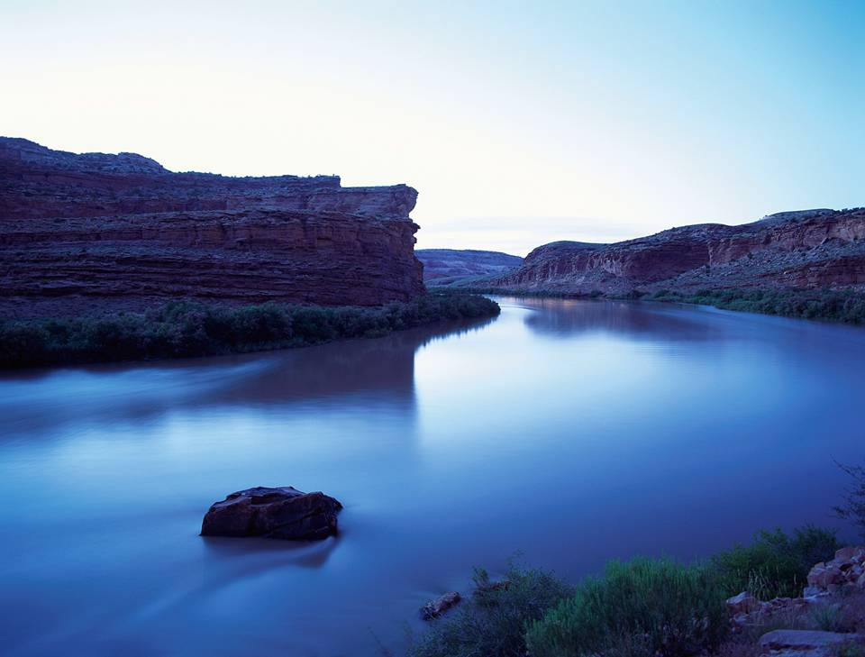
MARINE
ECOSYSTEM
FRESH WATER
ECOSYSTEM

Slide 6
Fresh water ECOSYSTEM
Freshwater is defined as having a low salt concentration—usually less than 1%
Plants and animals in freshwater regions are adjusted to the low salt content and would not be able to survive in areas of high salt concentration ( i.e, ocean )

Slide 7
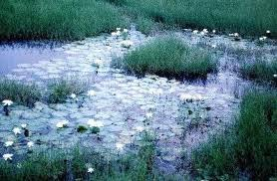
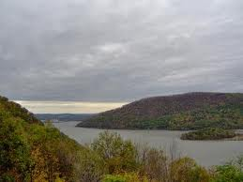
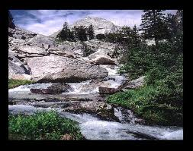
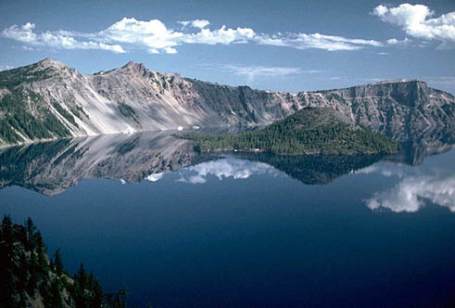
What are Aquatic FRESH WATER Ecosystems?
POND ECOSYSTEM
RIVER ECOSYSTEM
STREAM ECOSYSTEM
LAKE ECOSYSTEM

Slide 8
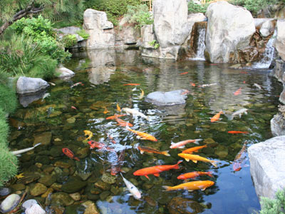
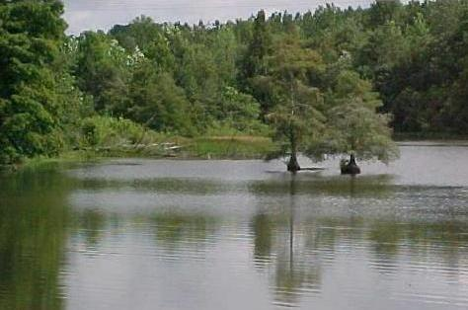
POND ecosystem
It is a self sufficient and self regulating ecosystem.
Location , size and depth of a pond influence the biology of the pond ecosystem.
A pond is a small body of fresh or salt water that is surrounded by land.
The water is mostly still and some ponds freeze in winter or dry up during drier weather.

Slide 9
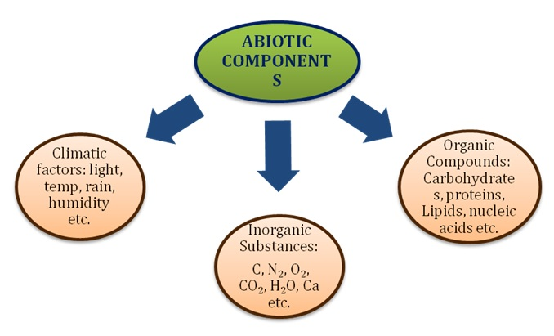
COMPONENTS OF POND ECOSYSTEM
ABIOTIC COMPONENTS :
The components are temperature, light, water, several
inorganic, organic (C,H,O,N), carbohydrates, proteins & lipids.
The amount of minerals present at any time in the physical
environment of the pond is known as standing state.

Slide 10
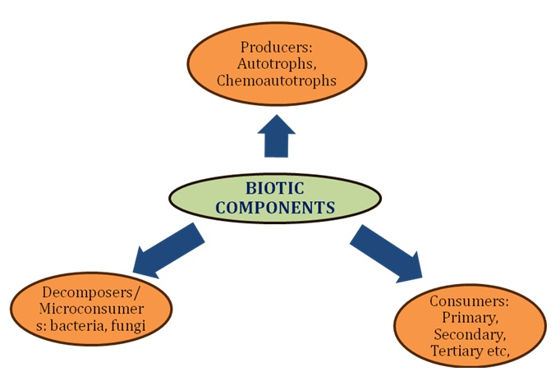
BIOTIC COMPONENTS :
(1) PRODUCERS :
Macrophytes, Green plants may be submerged, free floating &
Amphibious plants (e.g. Ceratophylium, Hydrilla, Utricularia,
Wolfia, Lemna, Pistia, Trapa, Azolla, Salvinia, Typha, Marsilea)
are found.
The minute Floating or phytoplanktons like algae and flagellates
(Ulothrix, Spirogyra, Oedogonium, Chalmydomoas,
Pandorina, Anabaena, Microcystis, diatoms etc.) are also present
Apart from these and photosynthetic bacteria are also present.

Slide 11
(2) CONSUMERS :
(I) PRIMARY CONSUMERS :
Zooplankton (ciliates, flagelltes,
other crustacean like copepods and daphnia, etc.).
They drift with the water current and the found along
with phytoplankton upon which they feed.
Benthos or bottom forms (e.g.,annelids and mollusks.).
(II) SECONDARY CONSUMERS :
Carnivores : they feed on the
herbivores, e.g., insects and fish.
(III) TERTIARY CONSUMERS :
Large fish : They feed on the
Smaller fish.

Slide 12
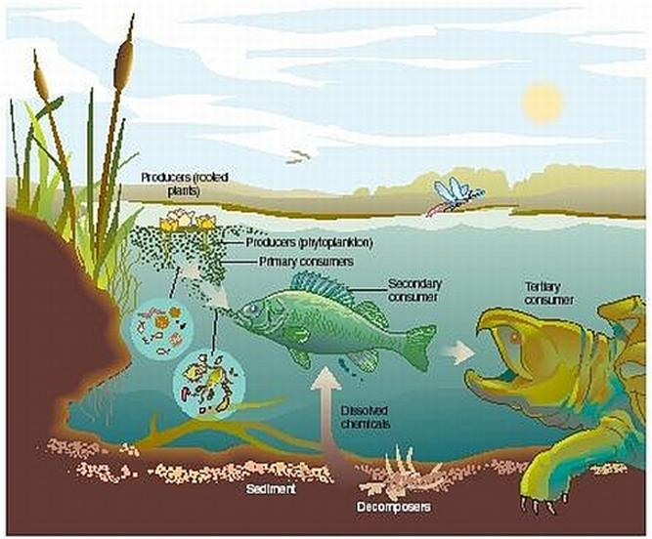
(3) DECOMPOSERS :
These are also known as micro consumers like bacteria, fungi
(Aspergillus, Cephalosporium, Phythium, etc.) and actinomycetes.

Slide 13
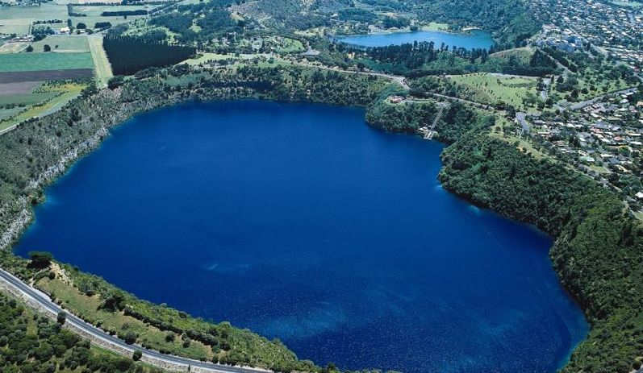
LAKE ECOSYSTEM :
A lake is a large body of water that is surrounded by land.
Some lakes are salt water, while others are fresh water.
Lakes get their water from rain and some are fed by rivers and streams
Lakes are usually big freshwater bodies with standing water.
Lakes have been found the exhibit distinct zones of biological activities, largely determined by the availability of light & oxygen.

Slide 14
BIOLOGICAL ZONES OF LAKE ECOSYSTEM :
EUPHOTIC ZONE :
The upper layer of water through which sun light
can penetrate. All plants growth occurs in this zone. In deep water
algae grows as the main plant.
(2) LITTORAL ZONE :
The shallow water near the shores in which rooted
plants. This zone can not extend deeper than euphotic zone.
(3) BENTHIC ZONE :
The bottom sediments in a lake comprise this zone.
As organisms living in overlying water die, they settle down to the
bottom, where they are decomposed by the organisms living in the
benthic zone.

Slide 15
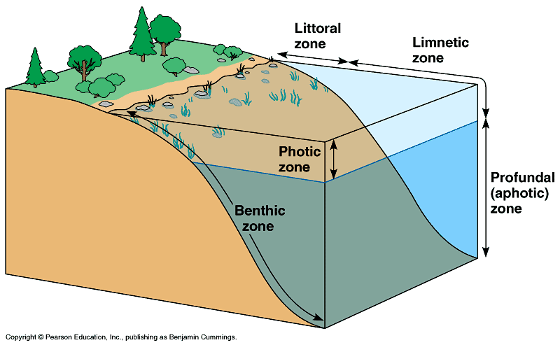

Slide 16
STRATIFICATION OF LAKE ECO SYSTEM :
The lakes show stratification on temperature difference. During summer,
The top water becomes warmer than then bottom waters. Therefore only
The warm top layer circulates without mixing with the colder layers, thus
Forming distinct layers.
EPLIMNION :
Warm, lighter, circulating surface water
(2) HYPOLIMNION :
Cold, viscous, non circulating, bottom layer.
(3) THERMO CLINE :
In between two layers, in which there is sharp
drop in temperatures.

Slide 17
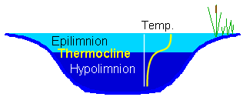
Layers of lake separated by density gradient.

Slide 18
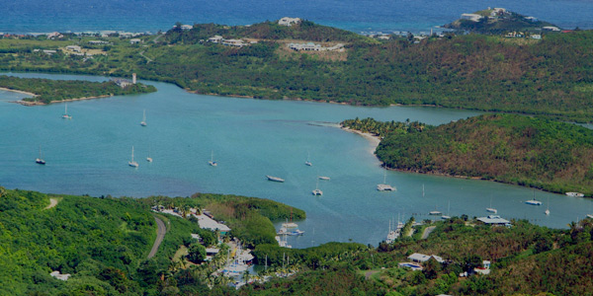
RIVER ECOSYSTEM :
Rivers are large streams that flow downwards from the mountain highlands and flowing through the plain falls into the sea.
A river is a long body of moving water. Rivers and streams get their water from rain, but also from melting snow and ice in the mountains.
The longest river in the world is the Nile River in Africa. It is over 4,000 miles long and flows through nine countries.

Slide 19
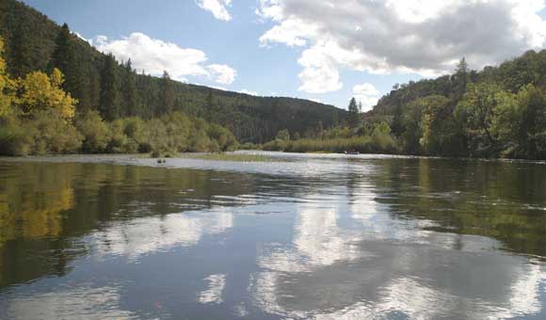
The mountain high land part has cold clear water rushing down as water falls with large amount of dissolved oxygen.
The plants are attached to rockand fishes are cold water, oxygen requires like trouts.
In second phase on the gentle slopes, the water are warmer and support a luxuriant growth of plants and less oxygen requires fishes.
In the third phase the river water are very rich in biotic diversity. Moving down the hills, rivers shape the land.

Slide 20
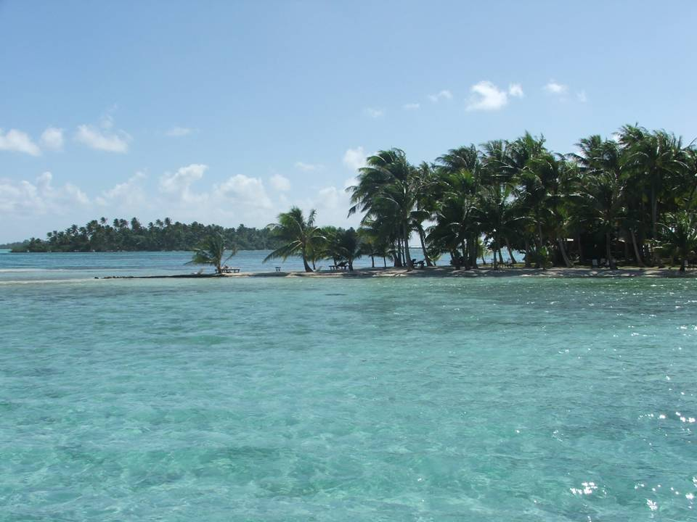
MARINE
ECOSYSTEM

Slide 21
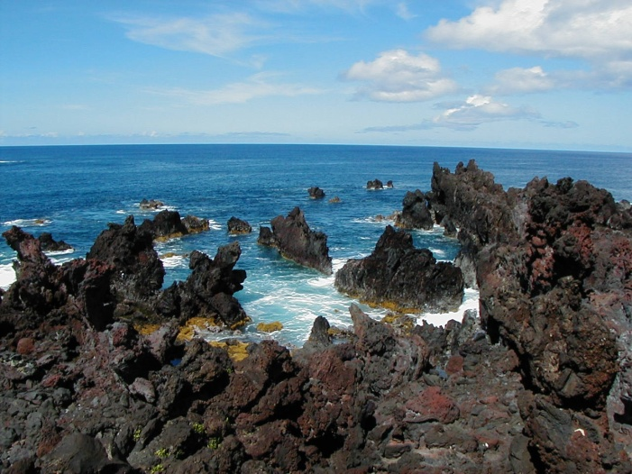
Marine ECOSYSTEMS
Cover about three-fourths of the Earth’s surface and include oceans, coral reefs, and estuaries.
Algae supply much of the world’s oxygen supply and take in a huge amount of atmospheric carbon dioxide.
Evaporation of the seawater provides rainwater for the land.

Slide 22
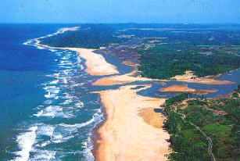
What are Aquatic MARINE Ecosystems?
OCEAN ECOSYSTEM
ESTAURINE ECOSYSTEM

Slide 23
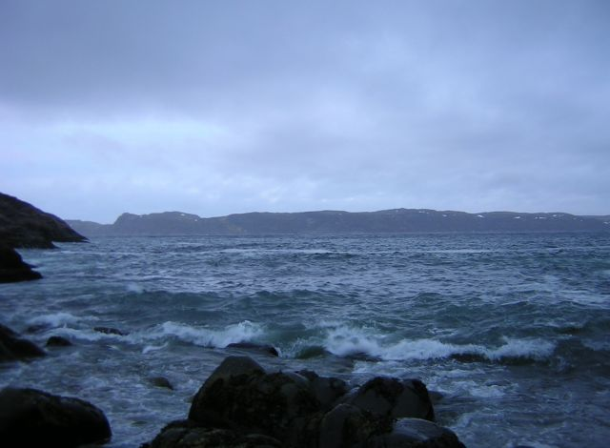
OCEAN ECOSYSTEM :
It covers about 70-71% of the earth surface. Ocean represent the largest most diverse and most stable of the ecosystem. It play a key role in survival of about 250000 marine species, serving as food for humans and other organisms, give a huge variety of sea products and drugs.
Ocean are major sinks of carbon dioxide and play an important role in regulating many biogeochemical cycles and hydrological cycle, thereby regulating the earth’s climate.

Slide 24
OCEAN ECOSYSTEM
COASTAL ZONE
OPEN SEA
EUPHOTIC ZONE
BENTHIC ZONE
ABYSSAL ZONE

Slide 25
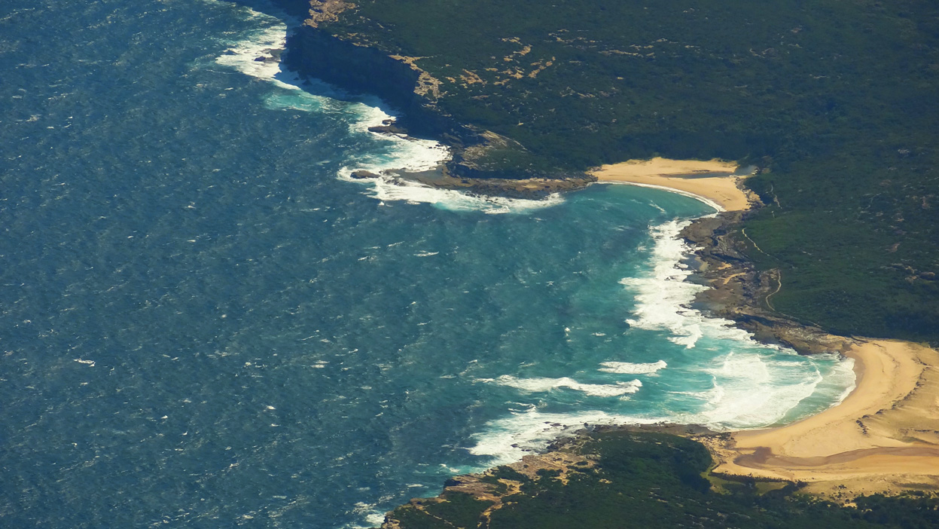
COASTAL ZONES :
It has relatively warm, nutrient rich shallow water.
Due to high nutrients and ample sunlight this the zone of high
primary productivity.
(2) OPEN SEA :
It is the dipper part of the ocean, away from the
continental shelf. It is vertically divided into three regions.
(I) Euphotic zone
(II) Benthic zone
(III) Abyssal zone

Slide 26
EUTHOTIC ZONE :
Which receives abundant light and shows high
photosynthetic activity. It hosts many species of fish, plankton,
marine mammals and some floating seaweeds.
(II) BENTHIC ZONE :
It is host to silt, sand & slowly decomposing
organisms. This area is very cold due to its depth which is unto-
uched by the sun. There are few plants & animals include mostly
bottom feeding organisms such as starfish, anemones sponges
as well as various micro organisms.
(III) ABYSSAL ZONE :
It is the deepest part of ocean. It is the world’s
largest ecological unit but it is incomplete ecosystem. It has no
primary sources of energy. This zone is very cold & pressurized.
Its floor features vents formed by spreading tectonic plates rele-
ases $H_{2}S$& other minerals which are consumed by bacteria, which
are then consumed by other micro organisms, which are in turn
consumed by the fish & so on.

Slide 27
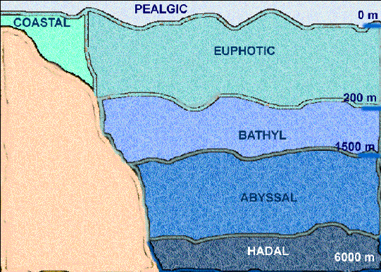
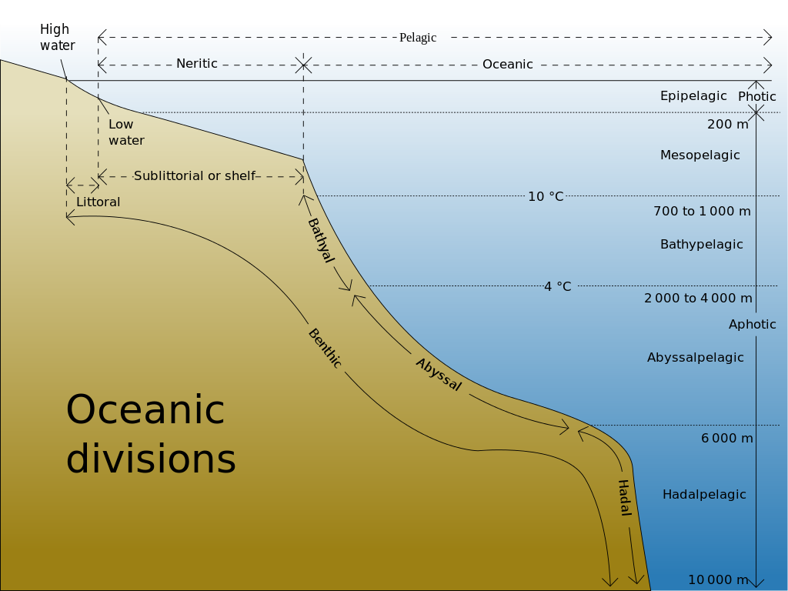

Slide 28
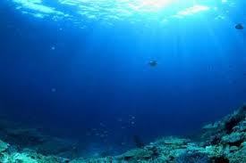
COMPONANTS OF MARINE ECOSYSTEM :
ABIOTIC COMPONANTS :
It is a more stable in chemical composition
due to big saline and more over other physico-chemical factors such
as dissolved oxygen constant, light & temperature are also different.
Marine water contains NaCl, Ca, Mg & K salts. Water is strongly bu-
ffered.
The concentration of disolved nutrients remains low, which constitu-
tes an important liming factor to determine the size of marine pop-
ulation. Ocean shows distinct zonations & waves of different kinds &
tides prevail there.
LIGHT

Slide 29
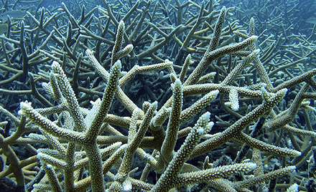
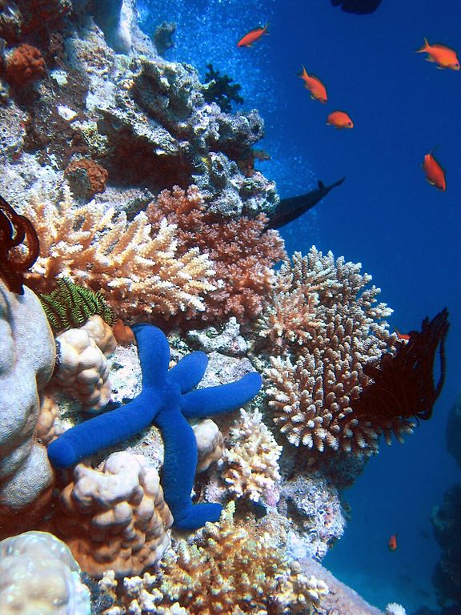
(2) BIOTIC COMPONANTS :
(I) PRODUCERS :
Phytoplanktons - diatom sand dinoflagillates marine
plants. sea weeds – mainly algae chlorophyceae, phaeophyceac.
angiosperms – ruppia, posidonia enhalus etc., mangrove – Carapa
sonneratia, aegiceros etc.

Slide 30
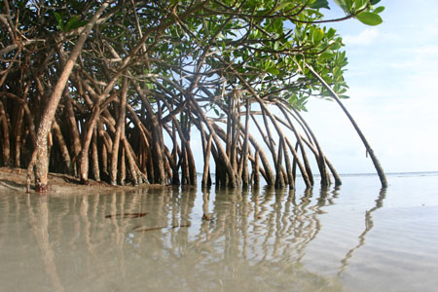
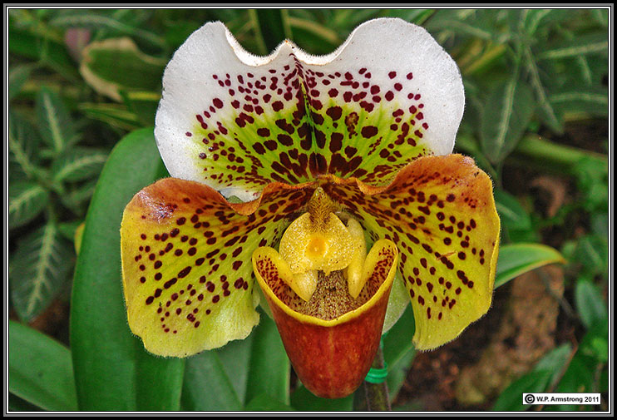
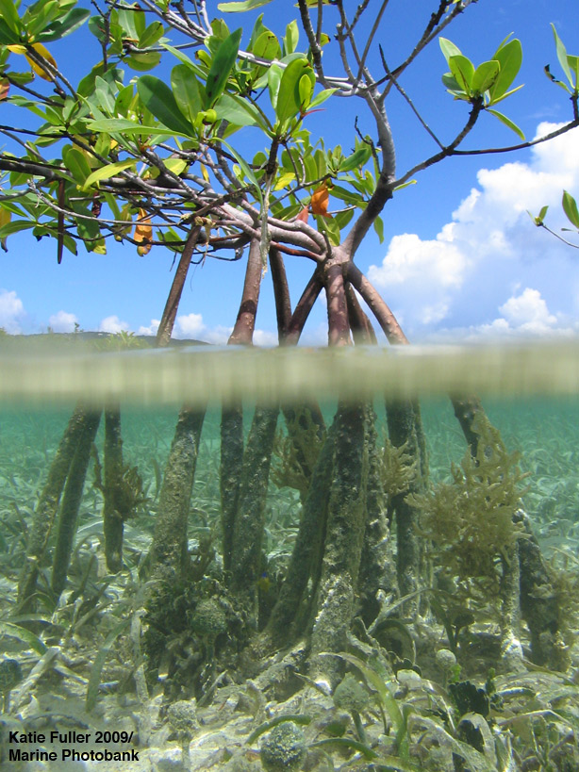
ANGIOSPERMS & MANGROVE
ANGIOSPERMS
MANGROVE

Slide 31
(II) CONSUMERS :
Heterotrophic macroconsumers : They are dep-
edent for their nutrition on the primary producers.
(A) PRIMARY CONSUMERS :
These are herbivores and feed directly
on producers e.g., crustaceans, fish etc.
(B) SECONDARY CONSUMERS :
Carnivorous fishes (Herring, sahd
Mackerel)
(C) TERTIARY CONSUMERS :
They are also called top consumers
like fishes (cod, haddock), etc.
(III) DECOMPOSERS :
Bacteria and some fungi. They decompose dead
organic matter.

Slide 32
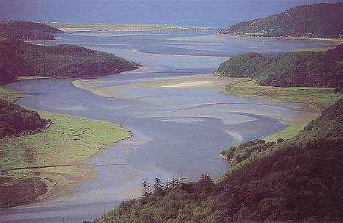
ESTUARINE
An area in which fresh water from a river mixes with salt water from the ocean; a transition area from the land to the ocean
Other names: bay, sound, lagoon, harbor, bayou.
The Ocean
Area where fresh and salt water mix
River bringing freshwater to the sea

Slide 33
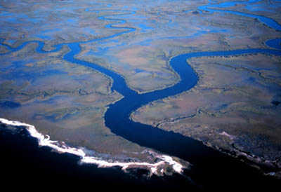
An estuary is a semi closed coastal body of water that has free connection
With sea. It is strongly affected by tidal action, and within this seawater
Is mixed with fresh water from land drainages.
River mouths, coastal bays Tidal marshes and bodies of water behind
beaches are some example of Estuarine ecosystem.
Estuaries are fresh water dumps in salt water. In estuarine brackish water
(less salty than water)
Estuaries are highly productive & biodiverse ecosystem. Estuaries are
much use to human beings due to their high food potentials. However
these ecosystem need to be managed judiciously and protected from
pollution.

Slide 34
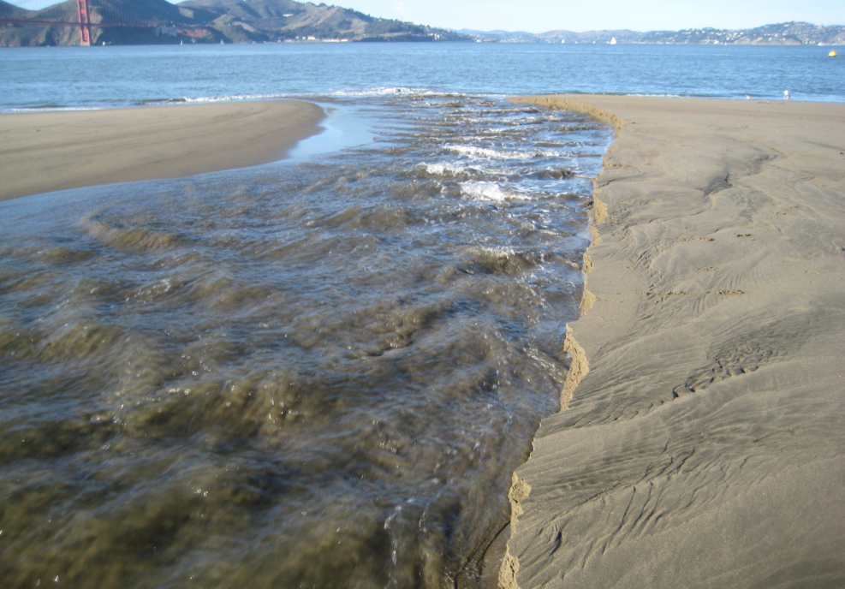
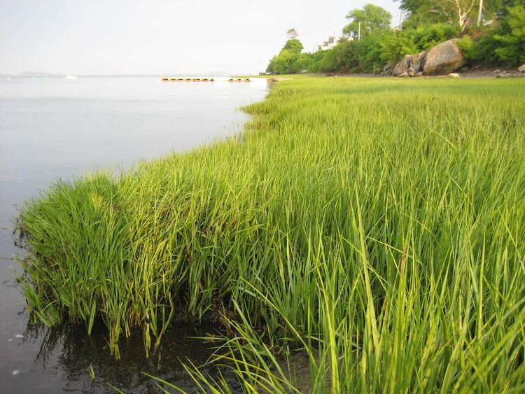
COMPONANTS OF ESTUARINE :
ABIOTIC COMPONANTS :
It includes inorganic substances like $CO_{2}$,
water, dissolved oxygen, nitrogen & inorganic salts of calcium and
magnesium as well as required micro & macro nutrients, organic
substances like carbohydrates, lipids & proteins & physical factors
like intensity & speed of current, cyclones & storms, tides, sun light
rain fall, soil, temperature & pH.
SOIL

Slide 35
(2) BIOTIC COMPONENTS :
It includes producers, consumers, & decom-
posers present in estuarine ecosystem.
(I) PRODUCERS :
Producers in the estuarine ecosystem are mainly
marsh grasses, sea weeds, mangroves & phytoplankton.
(II) CONSUMERS :
Main consumers found in marine ecosystem are
zooplankton, protozoa, crustacean, oysters, crabs & small to
medium fishes.
(III) DECOMPOSERS :
It includes basically bacteria & fungi which
act as decomposer to dead organic matter.

Slide 36
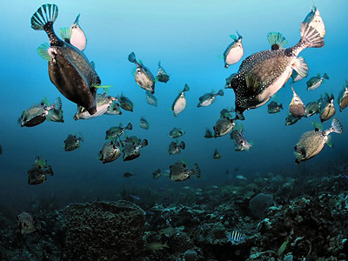
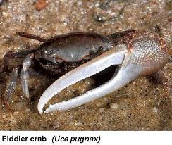
ESTUARINE LIFE

Slide 37
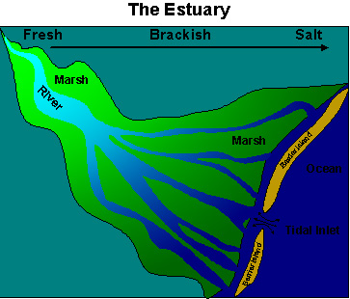
CHARACTERISTICS OF ESTUARIES
Water is brackish: a mixture of freshwater and saltwater
There is a gradient (gradual change) in the salinity
near the input from the river: 0-5 ppt
in the middle of the estuary: 5-25 ppt
at the ocean: >25 ppt
(ppt = parts per thousand, a unit for salinity)

Slide 38
MOBILE BAY – ONE OF THE LARGEST ESTUARIES IN THE U.S.
Tensaw River
Mobile River
Mobile Bay
Gulf of Mexico
Dauphin Island

Slide 39
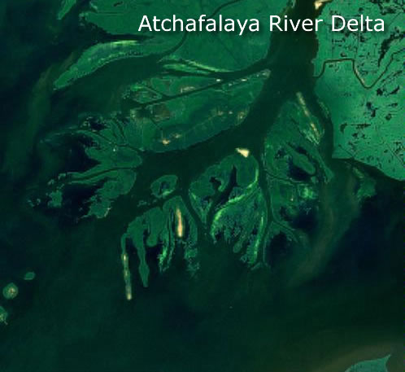
ATCHAFALAYA RIVER DELTA
This estuarine is in lousiana in the
united states. It is near the gulf
of maxico.

Slide 40
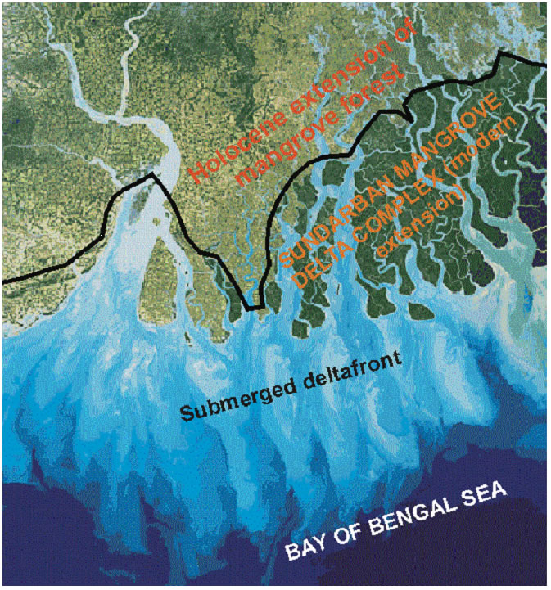
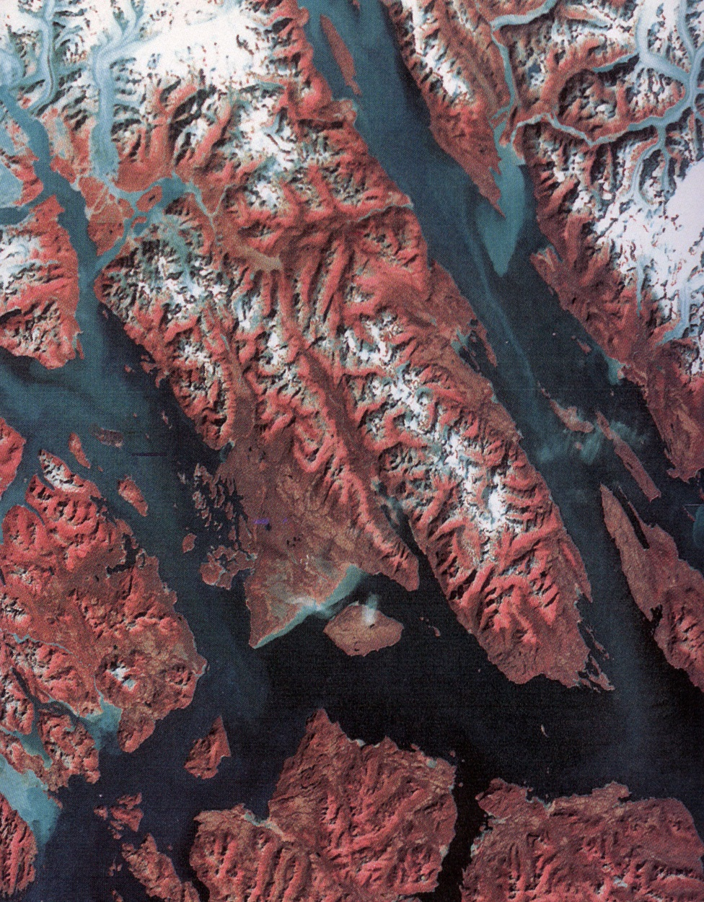
SUNDERBAN DELTA
INDIA - BANGLADESH
INCISED FJORDS
ALASKA

Slide 41
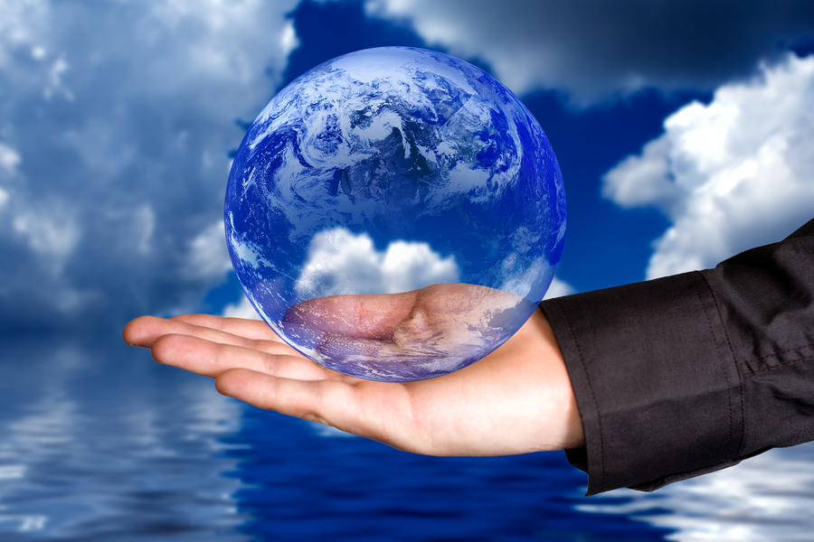
SAVE WATER, SAVE LIFE

